Slide 1
VX420: Business Basics for Entrepreneurship Week 1 Workshop Lean LaunchPad: New Approach to Entrepreneurship Development

Slide 2
Course Objective: Idea to a Business
What does it take to go from idea to a business?
Business Model + Customer Development
Hypotheses testing of the business model(s)
Get “out of the building”

Slide 3
Startups are a Smaller Version of a Large Company
Startups Search Companies Execute

Slide 4

Plan Meets
First Contact
With
Customers

Slide 5
Planning comes before the plan

Slide 6
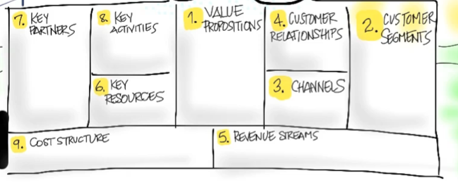
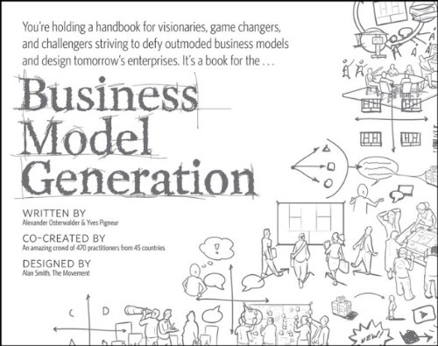
Business Models

Slide 7
Search
Execution
Business Model
Hypotheses
Operating Plan + Financial Model
Strategy

Slide 8
More startups fail from a lack of customers than from a failure of product development

Slide 9
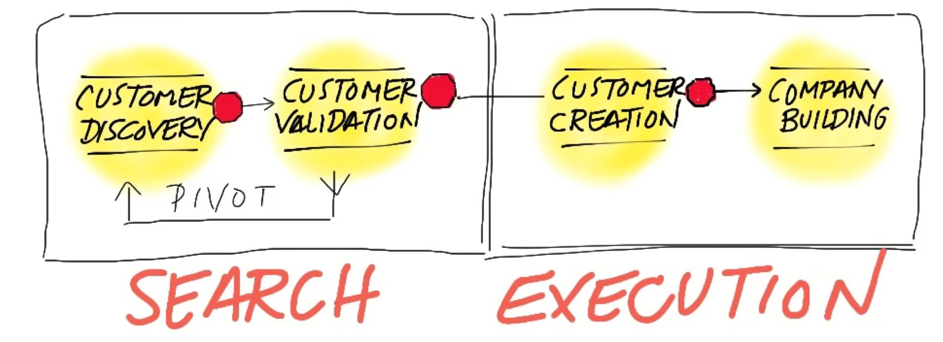
Customer Development

Slide 10
Search
Execution
Strategy
Business Model
Hypotheses
Operating Plan + Financial Model
Process
Customer &
Agile Development
Product Management
& Waterfall Development

Slide 11
Founders run a Customer Development Team No sales, marketing and business development

Slide 12
Search
Execution
Strategy
Business Model
Hypotheses
Operating Plan + Financial Model
Customer Development,
Agile Development
Product Management
Agile or Waterfall Development
Process
Customer
Development Team,
Founder-driven
Functional Organization
by Department
Organization

Slide 13
Entrepreneurial Education begins with the Search for a business model

Slide 14
Search
Execution
Strategy
Business Model
Hypotheses
Operating Plan + Financial Model
Process
Customer Development,
Agile Development
Product Management
Agile or Waterfall Development
Organization
Customer Development
Team, Founder-driven
Functional Organization
by Department
Education
Business Model Design, Customer Development, Startup team building, Entrepreneurial Finance, Agile Development, Customer Funnel: Get/Keep/Grow Market
Organizational Behavior, HR Mgmt, Accounting, Modeling, Strategy, Operations, Leadership, Marketing, Manufacturing

